Slide 1
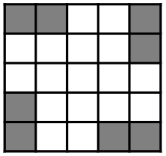
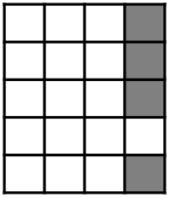
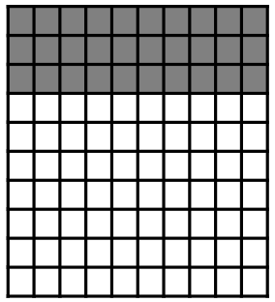
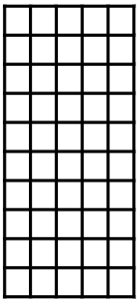
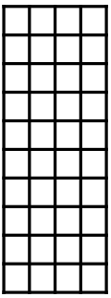
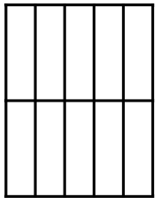

Checking understanding of percentages
Task A: Percentages, fractions and decimals
1) What proportion of the grid is shaded?
Give your answer as a percentage and a fraction.
2a) What proportion of the grid is shaded?
Give your answer as a percentage and a fraction.
2b) What percentage is shaded on the 100 grid on the right?
Shade the same percentage on grids A to G
B
A
C
D

Slide 2
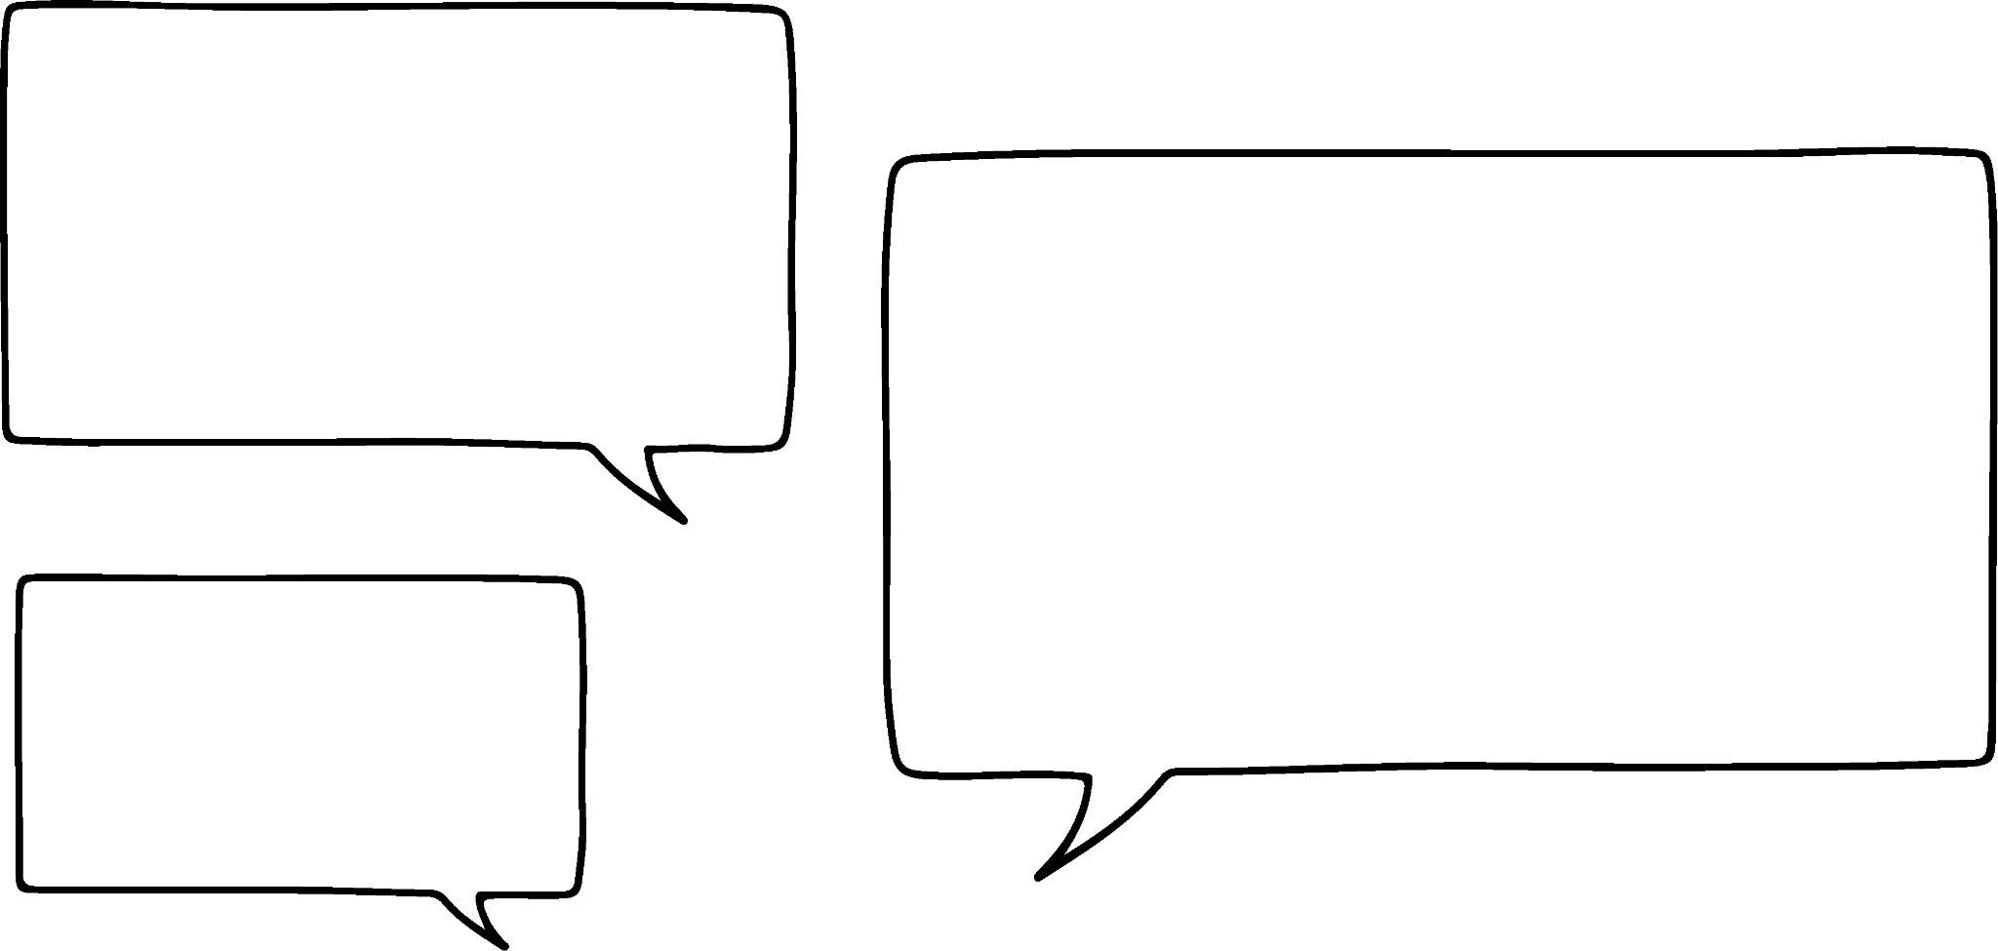



Checking understanding of percentages
Task B: Percentages of amounts
1) Work out the following:
a) 20% of 640
b) 30% of 520
c) 15% of 8
d) 35% of 30
2a) Who do you think is correct? Why?
2b) What percentages would the incorrect calculation(s) actually find?
Finding 20% of a number is easy. You just divide it by 20.
Finding 50% of a number is easy. You just divide it by 50.
Finding 10% of a number is easy. You just divide it by 10.
Aisha
Andeep
Izzy

Slide 3
Checking understanding of percentages
3) Below are six students’ different strategies for finding 75% of 250. One of them is incorrect.
Whose strategy is incorrect?
Explain the method used by each pupil.
Andeep
250 ÷ 100 = 2.5
2.5 × 75 = __
Aisha
250 ÷ 2 = 125
125 ÷ 2 = 62.5
125 + 62.5 = __
Sofia
250 ÷ 10 = 25
25 × 7 = 175
25÷ 2 = 12.5
175 + 12.5 = __
Jacob
250 ÷ 4 = 62.5
250 - 62.5 = __
Sam
250 ÷ 4 = 62.5
62.5 × 3 = __
Lucas
250 ÷ 75 = __
Mathematics in Education and Industry.
v2.3

